Slide 1

Sustainability of dinner recipes
Master thesis in clinical nutrition Aslaug Angelsen
Supervisors: Christoph Trattner and Alain Starke

Slide 2
Background

Slide 3
Consequences of unhealthy diets
Diet is a major contributing factor to morbidity and mortality (1).
Believed to cause 1 in 5 adult deaths and 15% of total adult disability adjusted life years.
Malnutrition is a contributing factor to the development and poor prognosis of many diseases, such as cardiovascular disease, cancer and diabetes type II.
1. Afshin, A. et al. Health effects of dietary risks in 195 countries, 1990–2017: a systematic analysis for the Global Burden of Disease Study 2017. Lancet 393, 1958–1972 (2019).

Slide 4
Environmental impact of our diets
Our current food system…
Uses 42-61% of ice-free land resources (1)
Accounts for 21-37% of total greenhouse gas emissions (2) and 70% of freshwater use (1)
Has negative impacts on soil quality, biodiversity, and cause pollution of air, land and water
A third of the food produced is wasted throughout the supply chain or at the consumer
Food waste is the third leading contributor to greenhouse gas emissions (3)
The food wastes stands for 23-24% of the land, freshwater and fertiliser used in food production (4)
Shukla, P. R. et al. Climate Change and Land: an IPCC special report on climate change, desertification, land degradation, sustainable land management, food security, and greenhouse gas fluxes in terrestrial ecosystems. (2019).
Crippa, M. et al. Food systems are responsible for a third of global anthropogenic GHG emissions. Nat. Food 2, 198–209 (2021).
Food and Agriculture Organization of the United Nations. Food Wastage Footprint Impacts on natural resources. Technical Report. 249 (2013).
Kummu, M. et al. Lost food, wasted resources: Global food supply chain losses and their impacts on freshwater, cropland, and fertiliser use. Sci. Total Environ. 438, 477–489 (2012).

Slide 5
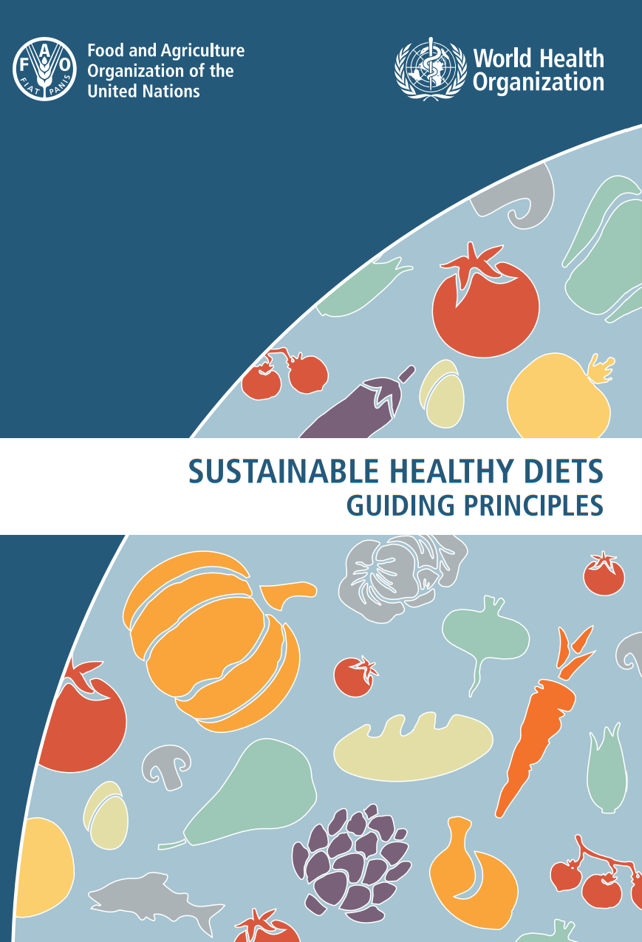
Sustainable diets
FAO and WHO have defined four domains of a sustainable diet:
Contribute to the healthiness and wellbeing of the individual
Has a low environmental impact
Is accessible, affordable, safe and equable
Is culturally acceptable

Slide 6
What are healthy, low environmental impact diets?
For both health and environmental sustainability, there are many different conflicting sources of information
Media, books, friends and family
Individuals must be (nutrition) literate to make sense of the information they are exposed to
Environmental sustainability have many domains
Greenhouse gas emissions, water stress, land use for humans or wildlife, biodiversity, animal welfare, pollution, eating locally grown seasonal produce
Large variation within and between food groups
Individual foods can be sustainable in one domain but not in others

Slide 7
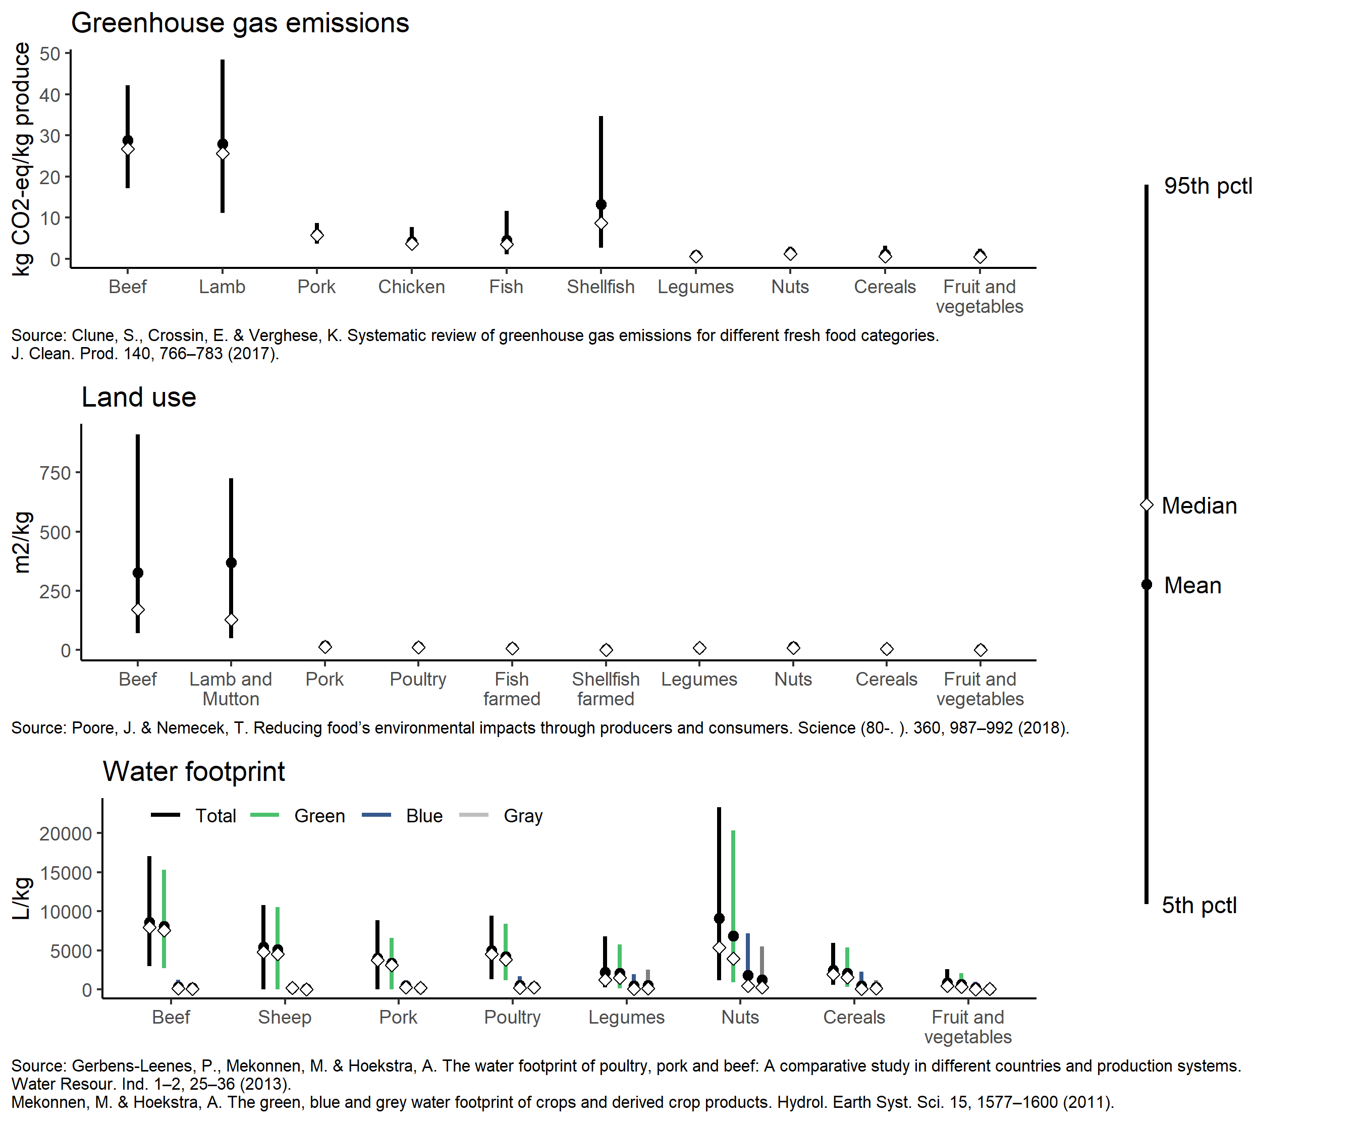

Slide 8
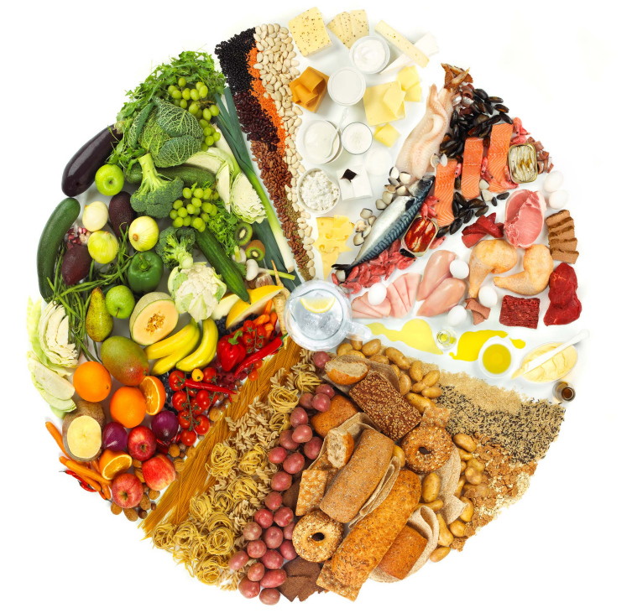
Dietary guidelines
Country/region specific healthy dietary patterns for the general population
Many similartities around the world – starchy staples, fruit and vegetable, whole grains, nuts, legumes, hiqh quality protein (1)
Few dietary guidelines incorporate environmental impact
Those that do (2) focus on local seasonal foods, organic foods, low-moderate intake of animal sourced foods
The encouragement of a high intake of starchy staple foods, fruit, vegetables, legumes and nuts likely mean these diets have low environmental impacts
Herforth A, Arimond M, Álvarez-Sánchez C, Coates J, Christianson K, Muehlhoff E. A Global Review of Food-Based Dietary Guidelines. [Online] Oxford University Press; 2019. p. 590–605
Braziil, Canada, Denmark, France, Germany, .Netherlands, Sweden, Qatar

Slide 9
Recipes
A source of inspiration and information for food choices
Can provide real-world data on how different foods are combined into meals by consumers around the world
Combined with databases on nutrition and environmental impact recipes can be used to find food combination that aligns with sustainable diet principles
Previous studies have found that recipes from various sources have low adherence to healthy dietary principles
No previous study have looked at environmental impact of recipes

Slide 10
Thesis aims
RQ1: How well do recipes from Norway, the UK and the US comply with healthy dietary guideline principles?
RQ2: To what extent does a recipe’s healthiness and environmental impact depend on country of origin?
RQ3: To what extent does environmental impact correlate with healthiness?

Slide 11
Methods

Slide 12
Data
A total of 600 recipes
100 from celebrity chef’s cookbooks from the UK (Baking Made Easy (7), River Cottage Everyday (21), Jamie's Ministry of Food (22), Jamie's 30 Minute Meals (25) and Nigella's Kitchen (25))
100 from the US recipe site Allrecipes.com
400 from four Norwegian recipe sites (Klikk.no (100), Tine.no (100), Aperitif.no (100), Kolonial.no (100) )

Slide 13
Calculating Nutrient Content
Nutrient content for each recipe was calculated by mapping the ingredients to the Norwegian nutrient database Matvaretabellen (2020 edition)
Ingredients not found were looked up in the US FoodData Central database or exchanged for a similar ingredient
These databases contain information about energy, macro- and micronutrient content of different foods per 100 g
Macronutrients were recalculated to energy percent, and micronutrients were recalculated to percent of required daily intake, fibre to grams per megajoule
Results were normalized to per 100 g of the recipe

Slide 14
Calculating Environmental Impact
The SHARP Indicator Database (1) was used to calculate each recipe’s environmental impact
Provides information on greenhouse gas emission in CO2 equivalents, and landuse in m2 per year per kg of various food items
Values were found for individual ingredients, and then summed for the whole recipe, and for individual foodgroups for each recipe
Results were normalized to per 100 g of a recipe
Mertens, E. et al. SHARP-Indicators Database towards a public database for environmental sustainability. Data Br. 27, (2019).

Slide 15
Other calculations
Composite ingredient’s nutrient content and environmental impact were calculated from recipes found online
Volume/weight conversion was done by using standardized weights from the “Weights, measures and portion sizes for foods” database from The Norwegian Directorate of Health
Supplied with standardized weights from US FoodData Central and grocery store product information
Missing values were imputed using the mean value of the same ingredient, normalized to per 100 g of a recipe

Slide 16
Recipe Healthiness Assessment
The World Health Organization and Nordic Nutrition Recommendation guidelines
Food Standard Agency’s Multi Traffic Light scoring system
Nutriscore

Slide 17
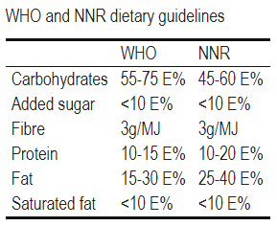
WHO and NNR guideline
Dietary guidelines promoting a healthy dietary pattern
How much energy should come from the three macronutrients carbohydrates, protein and fat
Limitations on saturated fat and added sugar content
Lower bound for fiber intake
1 point awarded for each recommendation in the guideline fulfilled
Score between 0-6
Higher score: Higher adherence, more healthy

Slide 18
FSA Multiple Traffic Light system
Color coded front of packaging label to help consumers in UK choose healthier options
A food’s fat, saturated fat, sugar and salt content are assessed and graded as red/high, amber/medium or green/low
Consumers are advised to choose foods with more green and amber than red
Originally, a red mark gives a score of 3, an amber of 2, and a green of 1 meaning a food can score between 4-12 and a higher score means a more unhealthy food.
Here, an inverted scoring system is used, and a higher score means a more healthy food.
This to be in line with the WHO and NNR guidelines

Slide 19
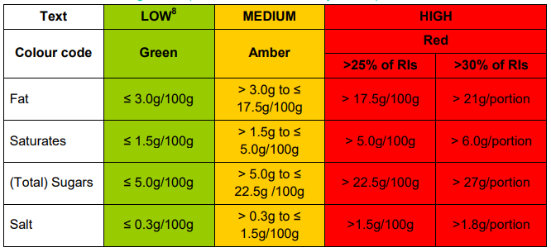
FSA Multiple Traffic Light System
Source: Guide to creating a front of pack (FoP) nutrition label for pre-packed products sold through retail outlets. (2016).

Slide 20
Nutriscore
Front of package label that builds on the traffic light system, but takes more components into account
Energy
Protein
Fibre
% of fruit, vegetables, legumes, nuts and olive/rapeseed/walnut oil in a food
Uses both “Qualifying” and “Disqualifying” components
Qualifying: Components that positively influence health
Disqualifying: Components that negatively influence health
Used around Europe
As with the traffic light score, an inverted Nutriscore was used

Slide 21
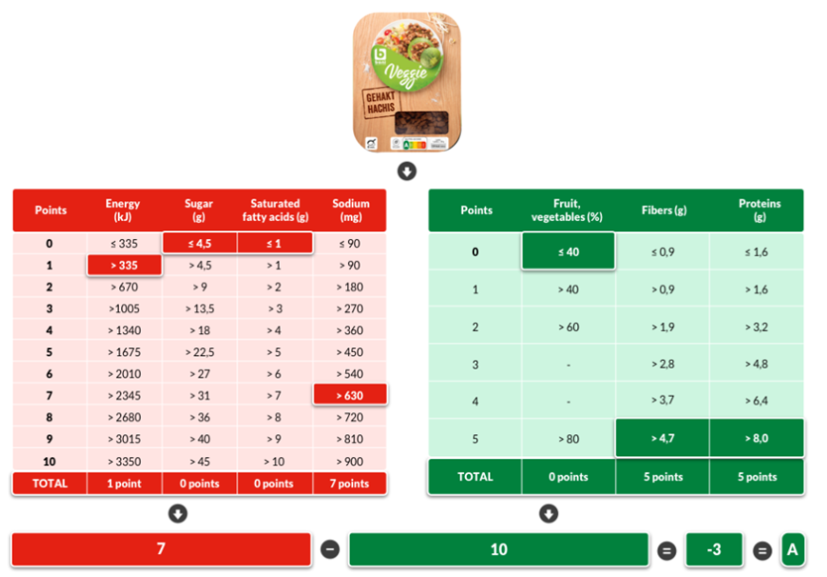
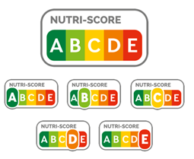
Nutriscore
Source: https://nutriscore.colruytgroup.com/colruytgroup/en/about-nutri-score/

Slide 22

Statistical Analysis
Recipes with >10% missing nutrient or environmental impact in weight per 100 g were not included in analyses
Between group differences
Kruskal-wallis with post-hoc Dunn test for between countries differences of healthiness and environmental impact indicators in addition to macro- and micro-nutrient content
Correction for multiple comparisons done with Benjamini Hochberg
Correlation
Correlation analysis of sustainability and healthiness markers were performed for each country individually, and all countries pooled using the Spearman method
Correction for multiple comparisons done with Benjamini Hochberg

Slide 23
Results

Slide 24
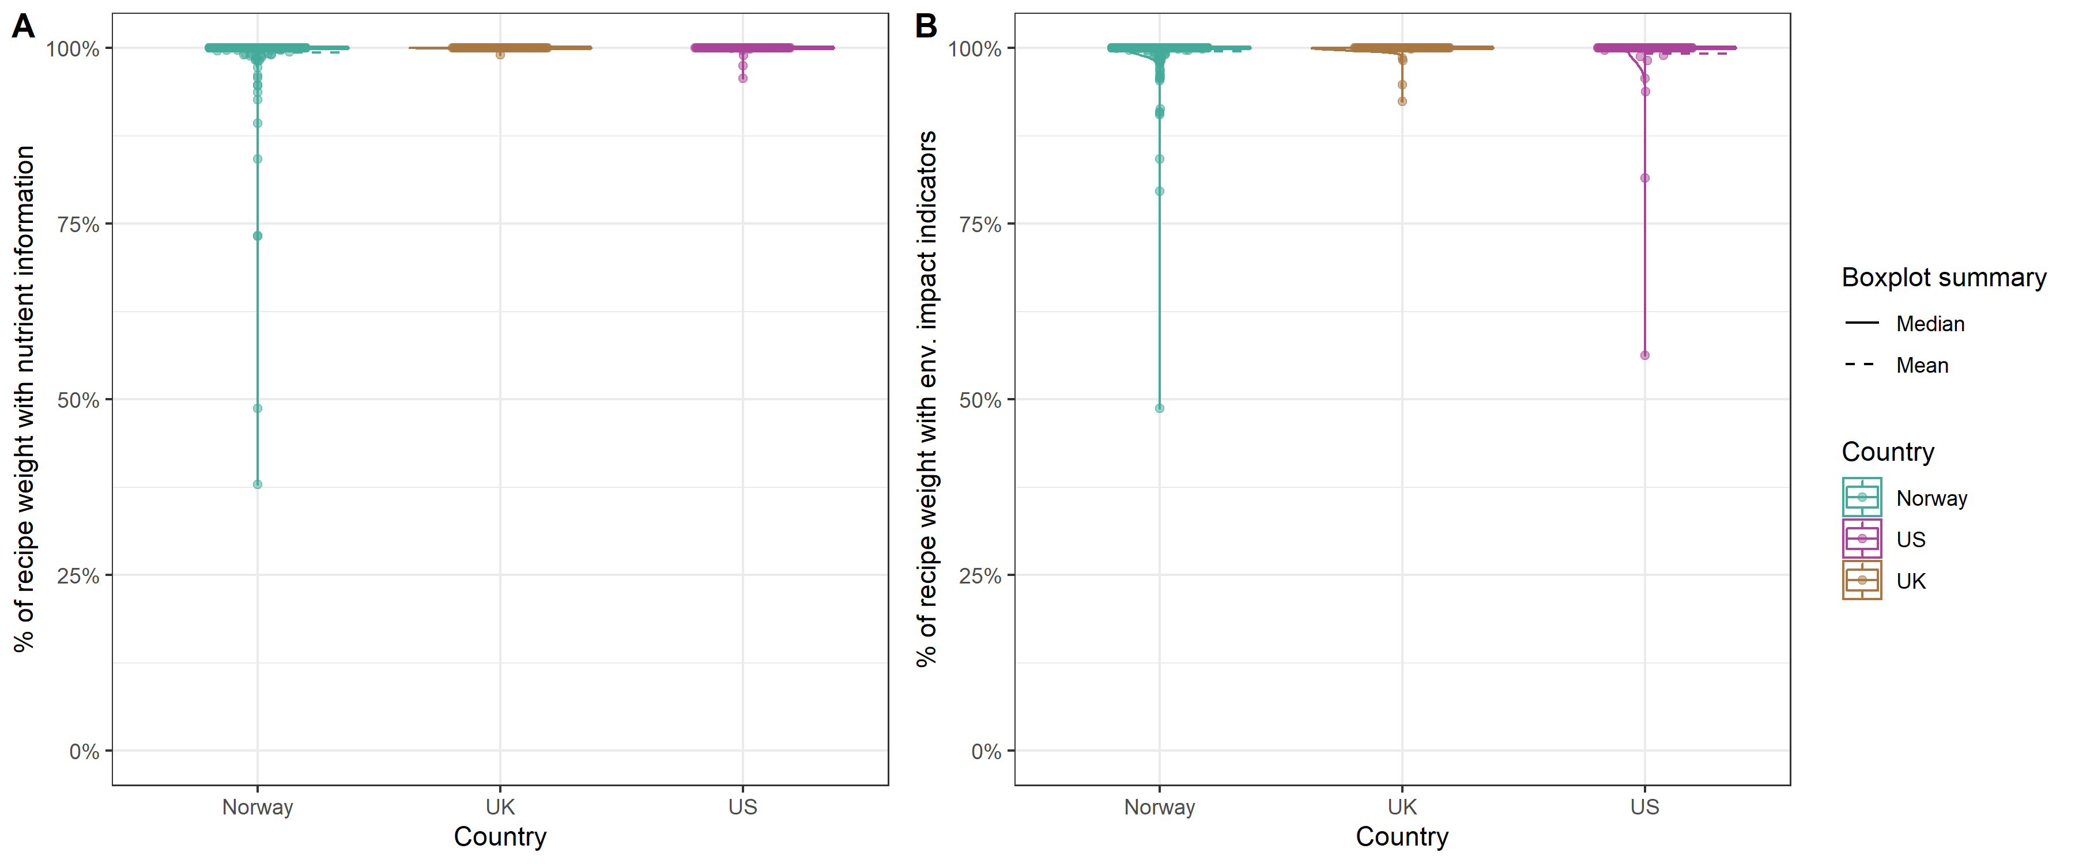
Data completeness
586 recipes were included in the analyses
One recipe lacked information about amounts of the ingredients
Eight recipes had >10% missing data
Five recipes were not dinner recipes

Slide 25
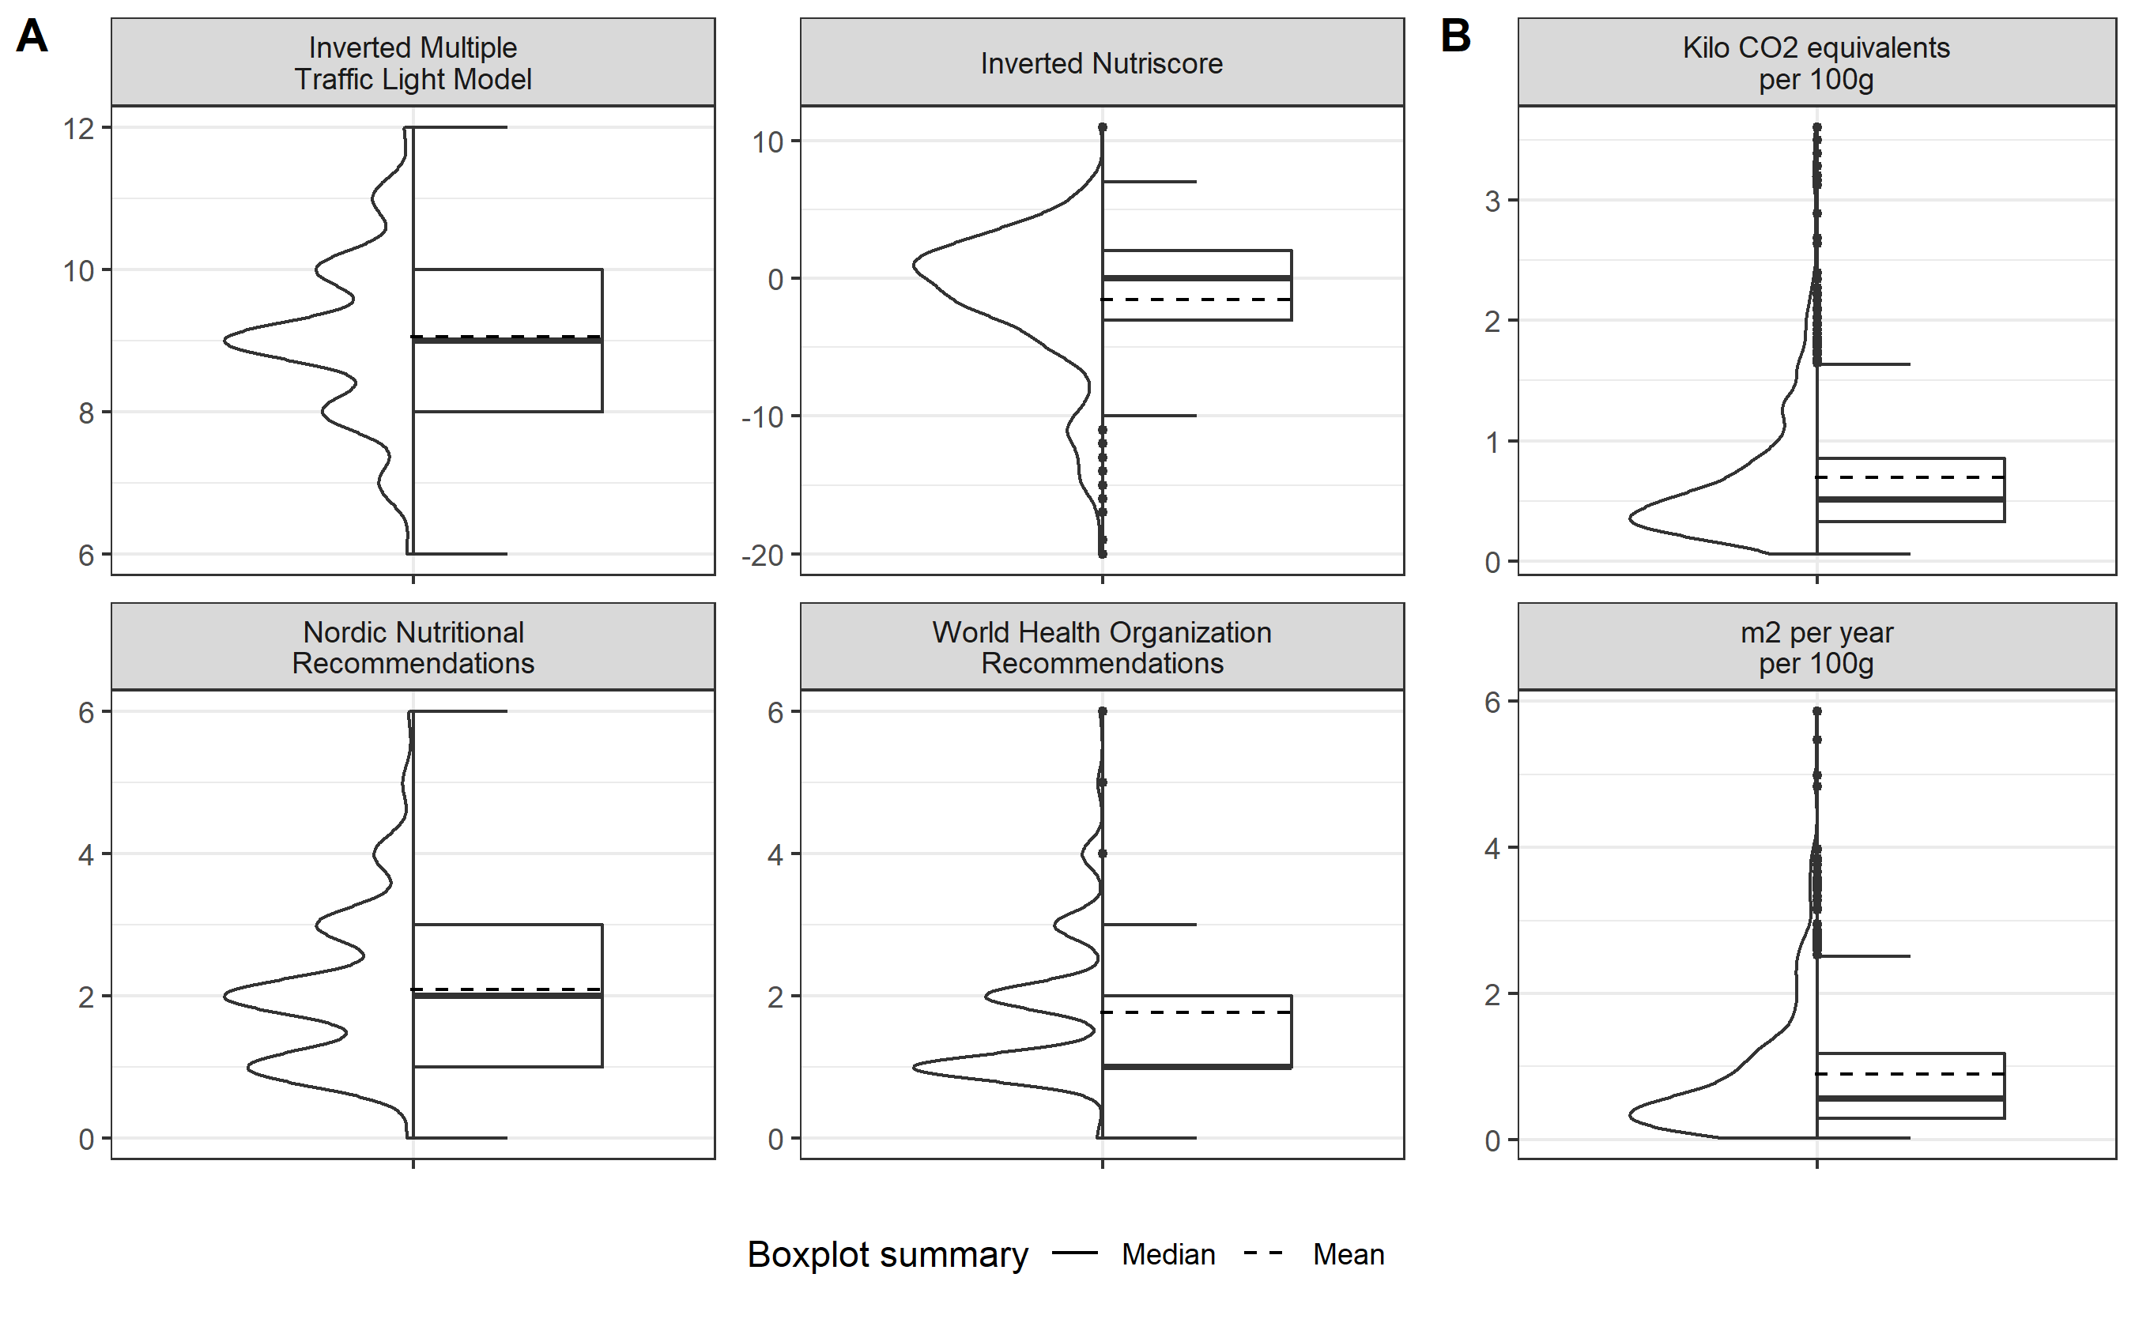
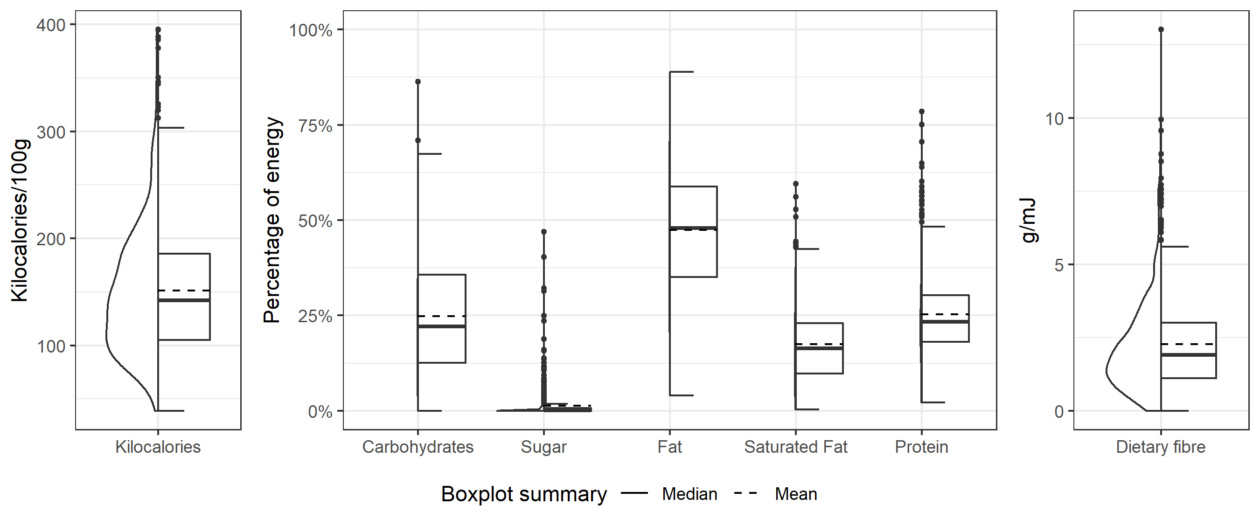
Recipe Sustainability
The median score on the NNR were 2, on the WHO 1
Many recipes could be consumed often as part of a healthy diet based on the Multiple Traffic Light system and the Nutriscore
Most of the energy came from fat, followed by protein and carbohydrates
Variation in CO2 emissions and landuse

Slide 26
Between countries difference

Slide 27
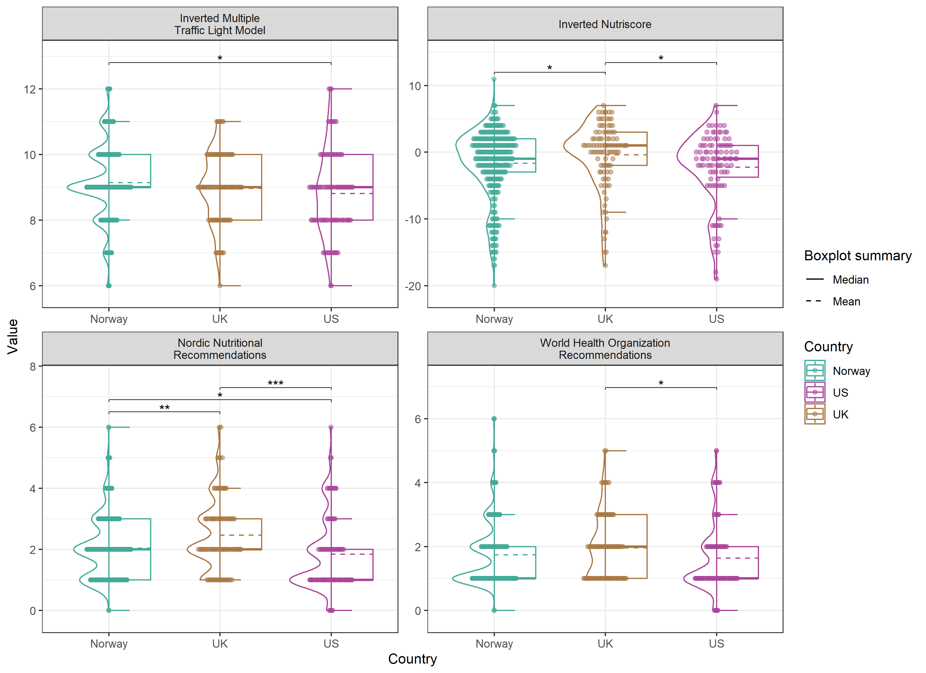
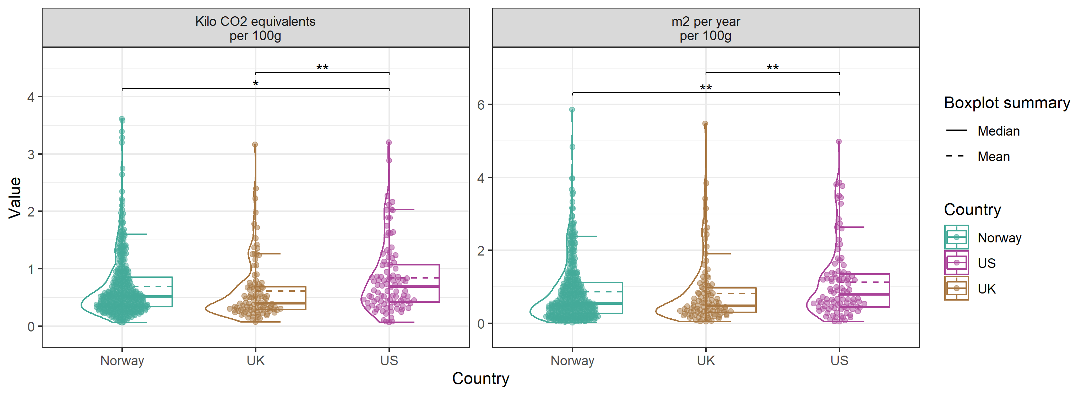
Between countries comparison
UK recipes scored better on healthiness indicators except for the multiple traffic lights
US recipes had the worst environmental impact
Small absolute differences on total healthiness scores and environmental impact

Slide 28
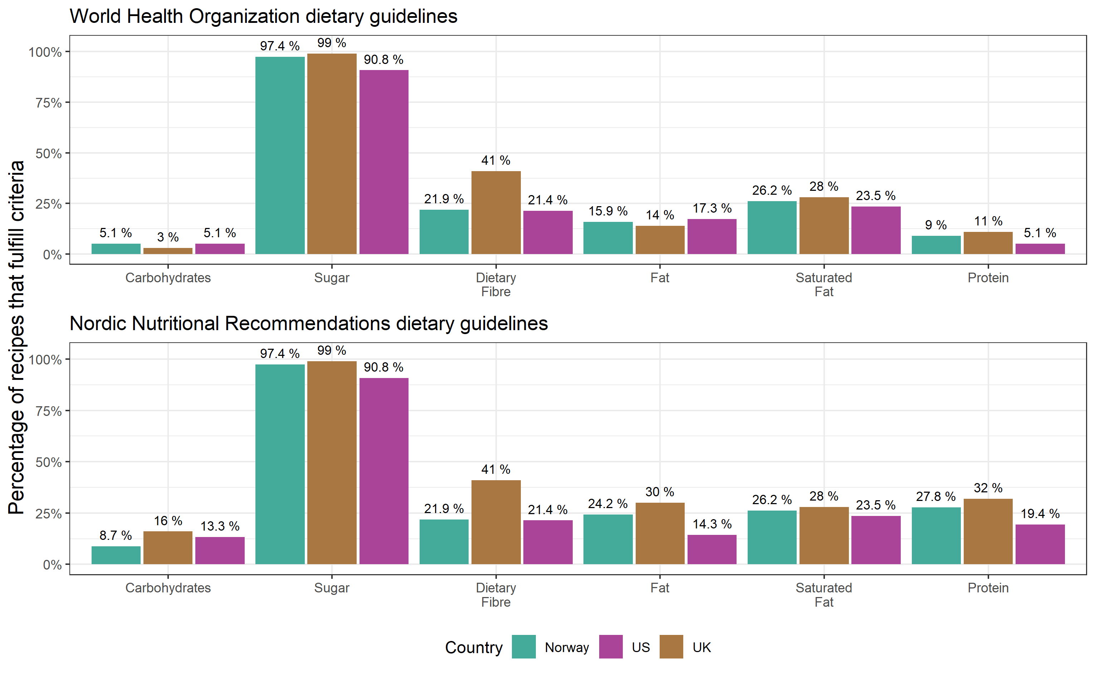
Differences between countries – Guideline scores
For the nutrients carbohydrates, fat and protein, more recipes were compliant with NNR than WHO
UK recipes tended to score better than recipes from the US or Norway
Recommendations for saturated fat, dietary fibre and added sugar were the same in the two guidelines

Slide 29
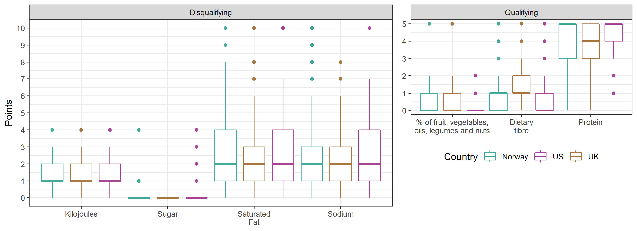
Difference between countries Nutriscore
Similar patterns on Nutriscore component scores between countries

Slide 30
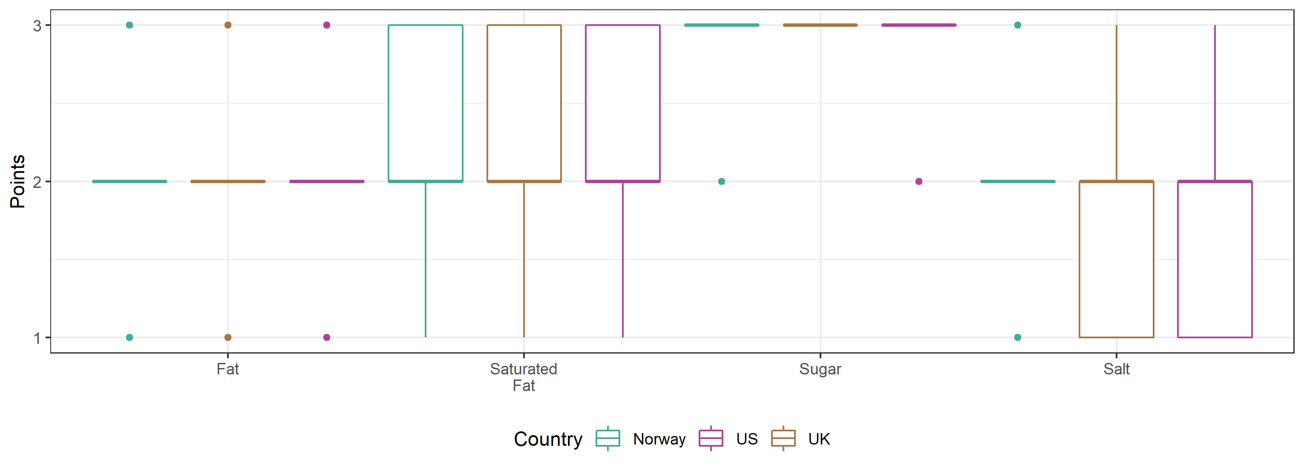
Difference between countries - Multiple Traffic Lights
Similar patterns in multiple traffic light component scores between countries

Slide 31
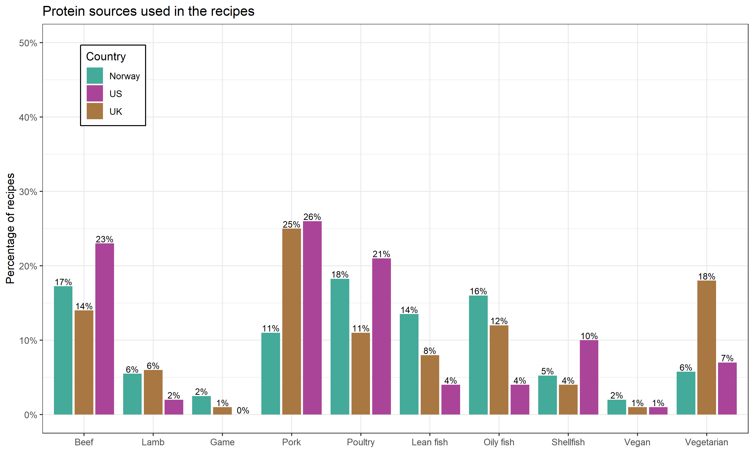
Difference between countries – Source of Protein
Most recipes used red meat as a source of protein
For Norway and the UK, the second most used source of protein was seafood, in the US poultry
Some differences in type of seafood between countries
Few recipes were vegetarian or vegan
UK had the highest percentage of vegetarian/vegan recipes

Slide 32
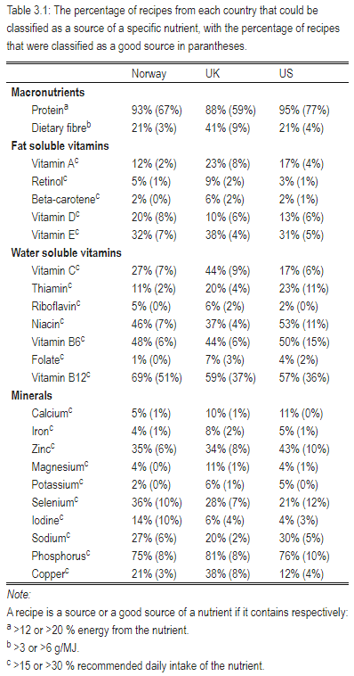
Recipe nutrient content
Nearly all recipes were a source of protein and phosphorus
For protein, most were good sources
UK had more recipes that were sources of nutrients found in plants
Dietary fibre, beta-carotene, vitamin C, folate (iron, magnesium, copper)
Norway had more recipes that were sources of iodine and vitamin D
More fish based recipes

Slide 33
Correlation between Healthiness and Environmental sustainability

Slide 34
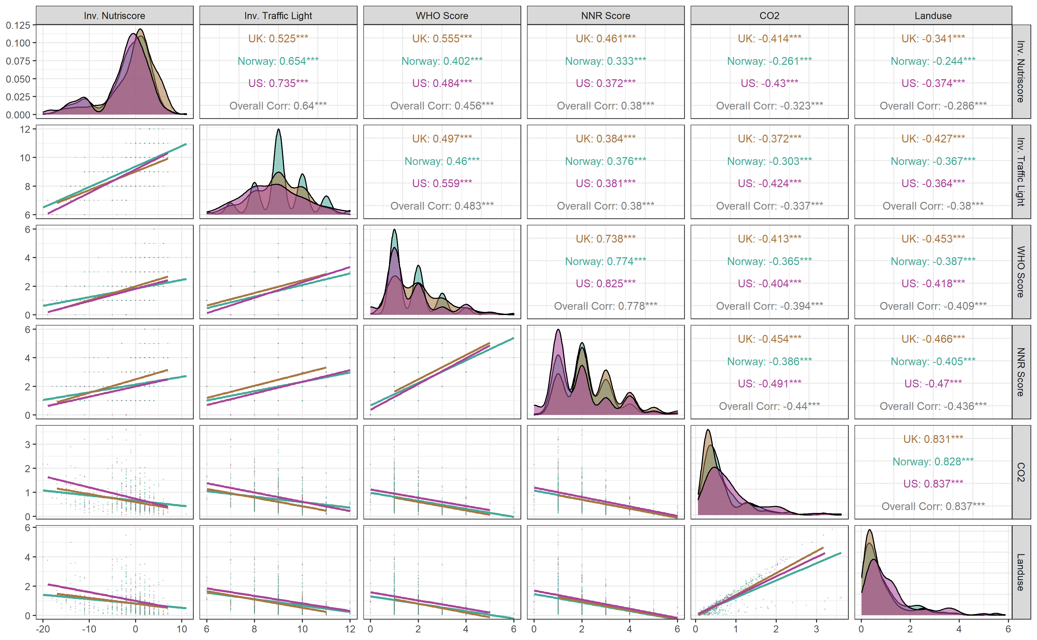
Correlation Healthiness-Environmental impact
All healthiness indicators negatively correlated with environmental impact
NNR guidelines had the strongest correlation, followed by WHO guidelines, Multiple Traffic Light and the Nutriscore

Slide 35
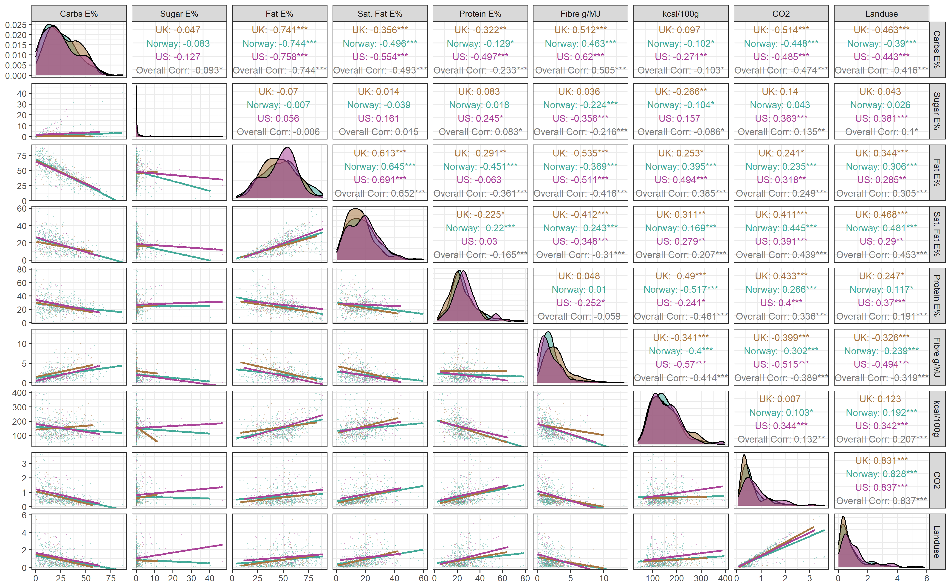
Correlation Energy-environmental Impact
Carbohydrates and fibre were negatively correlated with environmental impact
Sugar positively correlated with environmental impact
Total energy, protein, fat (especially saturated fat) were positively correlated with environmental impact

Slide 36
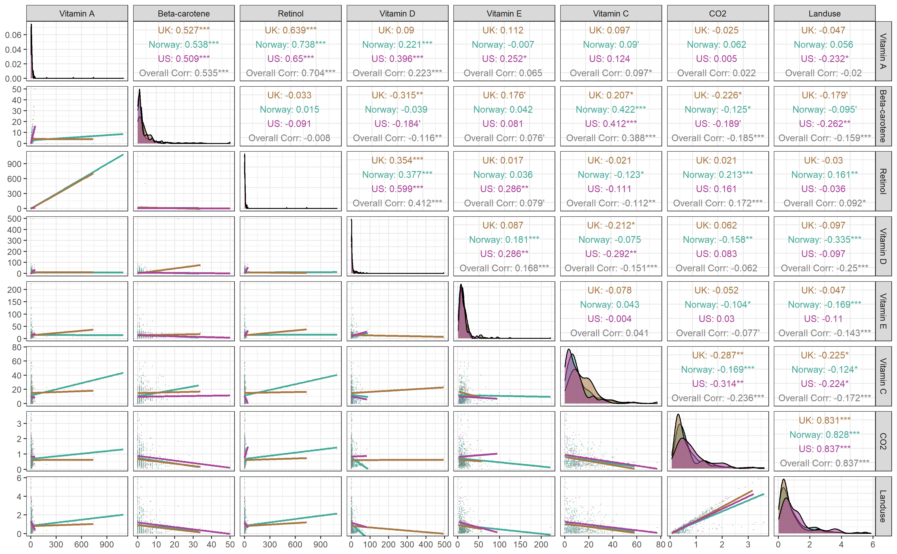
Correlation vitamins-Environmental Impact
Retinol, but not vitamin A, positively correlated with environmental impact
Beta-carotene, vitamin E and C negatively correlated with environmental impact, vitamin D only with landuse

Slide 37
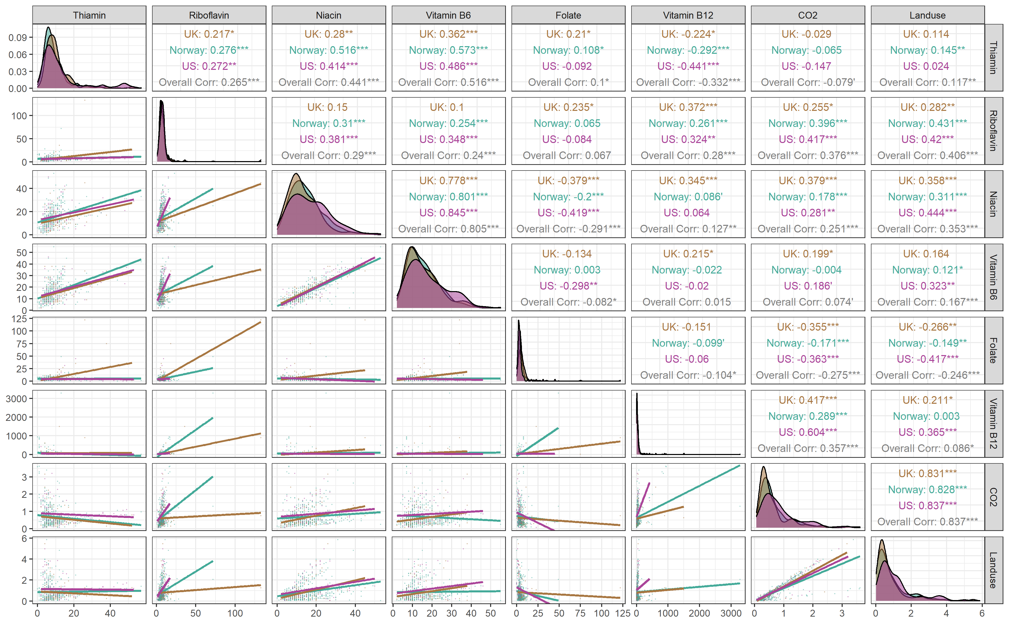
Correlation vitamins-Environmental Impact
Vitamins B2, B3, B6 and B12 positively correlated with environmental impact. Vitamin B1 negatively correlated with CO2 but positively correlated with landuse
Vitamin B9 negatively correlated with environmental impact

Slide 38
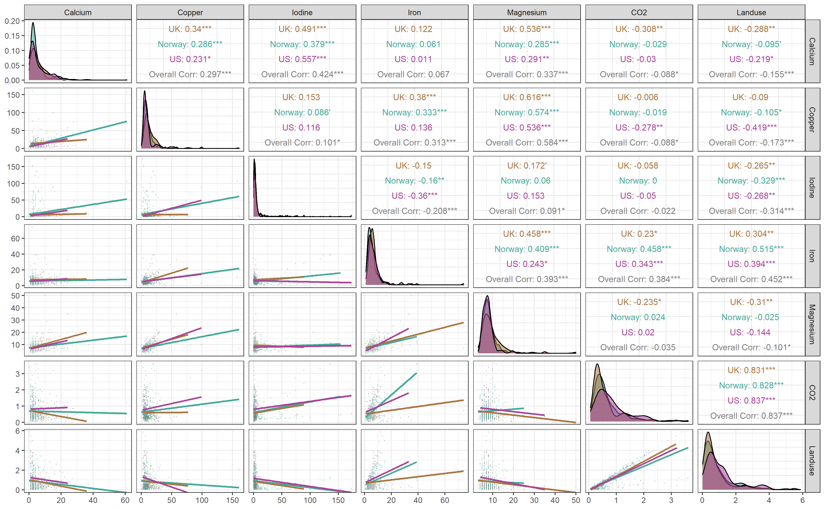
Correlation Minerals-Environmental Impact
Iron positively correlated with environmental impact
Calcium and copper negatively correlated with environmental impact, magnesium and iodine only with landuse

Slide 39
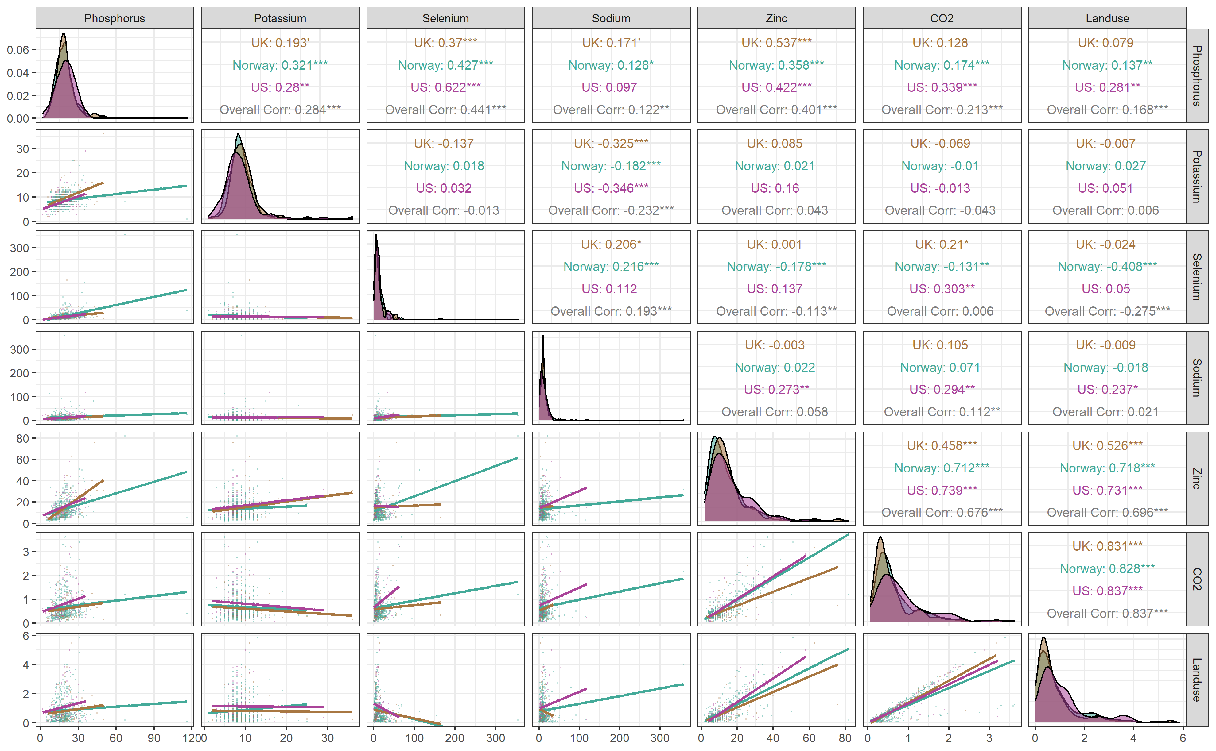
Correlation Minerals-Environmental Impact
Phosphorus and zinc positively correlated with environmental impact, sodium only with CO2
Selenium negatively correlated with landuse

Slide 40
Discussion

Slide 41
Healthiness of the recipes
There were only small differences between countries on the variables in the study
In line with previous studies that have used WHO guideline criteria to classify recipe healthiness, few recipes complied fully with the critieria.

Slide 42
Healthiness of the recipes
There were only small differences between countries on the variables in the study
In line with previous studies that have used WHO guideline criteria to classify recipe healthiness, few recipes complied fully with the critieria.
Similarly, few recipes complied fully with NNR criteria although more than with the WHO
NNR has allows for higher intake of total fat and protein, but lower carbohydrates

Slide 43
Healthiness of the recipes
There were only small differences between countries on the variables in the study
On front of pack label criteria, most recipe could be eaten often as part of a healthy diet
Different than previous studies with FSA multiple traffic light criteria
Likely due to different interpretation of criteria and different multiple traffic light systems used
No previous study have used the Nutriscore to classify the healthiness of recipes

Slide 44
Environmental impact of the recipes
There were only small differences between countries on the variables in the study
Any relevant thresholds?
US recipes were significantly higher in CO2 emissions and landuse, although in absolute numbers the difference was small
Likely due to more red meat

Slide 45
Differences between dietary guidelines and front of pack labels
Dietary guidelines and front of pack labels are not the same
Dietary guidelines are not meant to be used for single meals
Front of pack labels are not meant to classify foods that comply completely with dietary guidelines, but rather guide the consumer towards healthier choices

Slide 46
Correlation between healthiness & environmental impact
All healthiness indicators were negatively correlated with environmental impact
Guidelines more than front of pack labels

Slide 47
Correlation between healthiness & environmental impact
All healthiness indicators were negatively correlated with environmental impact
Guidelines more than front of pack labels
Guidelines include requirements for high carbohydrate content, while penalizing high protein content
Promotes low environmental impact foods such as starchy staples, vegetables, fruit
Penalizes recipes with a high amount of animal sourced foods

Slide 48
Correlation between healthiness & environmental impact
All healthiness indicators were negatively correlated with environmental impact
Guidelines more than front of pack labels
Front of pack labels did not penalize high protein content, or promote a high intake of starchy staples
Nutriscore rewards high protein recipes, but also dietary fibre and amounts of vegetables, fruits, legumes, nuts and healthy oils
Promotes healthier foods, animal sourced protein low in saturated fat and plant based foods high in fibre
Animal sourced foods still have high environmental impact, not all low-environmental impact carbohydrate rich foods are high in fibre
Multiple traffic light only penalizes saturated fat content

Slide 49
Correlation between healthiness & environmental impact
Nutrients predominantly/only found in animal sourced foods positively correlated with environmental impact
Retinol, vitamin B12, iron, zinc, saturated fat
Nutrients predominantly/exclusively found in plant based foods negatively correlated with environmental impact
Carbohydrates, fibre, vitamin C, folate
Sugar stood out and was positively correlated with environmental impact
Likely an artefact due to sugar being used in sauces and marinades in meat based recipes
Important to include micronutrients when designing environmental sustainable diets!
Micronutrient deficiencies are common, not only in low- middle-income countries

Slide 50
Adherence to other guideline recommendations
Few recipes used fish as a source of protein
Unfortunate as fish is a good source of many important nutrients, and dietary guidelines from Norway and the UK include specific criteria for fish intake
Of the countries included, Norway had the highest reommendation for fish intake in their dietary guidelines, US the lowest
Also reflected in the data
Few recipes were vegan or vegetarian
All countries’ dietary guidelines recommend plant based foods
The most used protein source was red meat
Norway and the UK have upper limits for red meat intake in their dietary guidelines
Few recipes specified that whole grain alternatives should be used for grain based ingredients
Also recommended in all countries’ guidelines

Slide 51
Limitations
Recipes may be missing ingredients that could influence the analyses, or be misclassified
Additional ingredients could be specified in the recipe description, such as «serve with potatoes»
Recipes collected from websites may be misclassified, f.ex. a dessert may be classified as a dinner
Not all ingredients in a recipe is for eating, such as marinades
The nutrient content from these ingredients should not be counted in full
Environmental impact still the same
Portion sizes may have given results with more real word relevance
Only healthiness and environmental sustainability assessed out of the four domains of sustainable diets
Few environmental impact indicators
Only looked at dinner recipes, mealplans may have given a more relevant assessment of environmental impact and nutritional adequacy
Recipes and databases could contain errors

Slide 52
Thesis aims
RQ1: How well do recipes from Norway, the UK and the US comply with healthy dietary guideline principles?
RQ2: To what extent does a recipe’s healthiness and environmental impact depend on country of origin?
RQ3: To what extent does environmental impact correlate with healthiness?

Slide 53
Summary
Healthiness assessment of dinner recipes were worse using dietary guidelines from WHO and NNR compared to front-of-pack label algorithms
There are small absolute differences between healthiness, nutrient content and environmental impact between recipes from the UK, Norway and the US
All healthiness indicators was negatively correlated with environmental impact
Nutrients found predominantly in animal sourced foods were positively correlated with environmental impact
Nutrients found predominantly in plant based foods were negatively correlated with environmental impact

Slide 54
Further research
Look at other recipes
Meal plans
Recipes with different sources of protein
Use portion sizes
Substitution analyses
Include more environmental impact indicators
Water footprint, impact on biodiversity, eutrophication
Include other sustainable diet domains
Price, acceptability
Should use meal specific healthiness criteria

Slide 55
Current Problems
Markdown
Dropped PCA as it gave no extra information
Want to include something on recipes and food waste
Meal planning
But recipes can also increase food waste (buying ingredients never used again/that gets thrown out)

Slide 56
Article disposition
Use recipe subchapter, with info on dietary guidelines changing to incorporate sustainability, consumer beliefs about sustainability, health/environmental consequences of current dietary practices
Condense the methods chapter
Results showing the number of recipes that use red meat/seafood/are meat-free and the amounts of each food group in the recipes can be moved to the appendix

